Slide 1


IV. Performance and scalability

Slide 2
References
Advanced R: https://adv-r.hadley.nz/index.html
Clean Code
List of R packages used for High Performance Computing: https://cran.r-project.org/web/views/HighPerformanceComputing.html

Slide 3
A warning
We will get into intermediate/advanced R programming concept
You are unlikely to understand everything
This is expected, it does not mean you are bad at R programming
At some point in your career, you will need to use some of the tools I list here
See this as some preview so you are aware of their existence, and come back to these slides when this time comes
Everything will make a lot more sense when you have more experience

Slide 4
Reminder: Github
Try Git (+ GitHub, GitLab…)
Version control software: keeps track of all modifications in files of a project
Great when working alone to keep a history of all changes you have made
Great when working with others, to check new modifications, review their code…

Slide 5
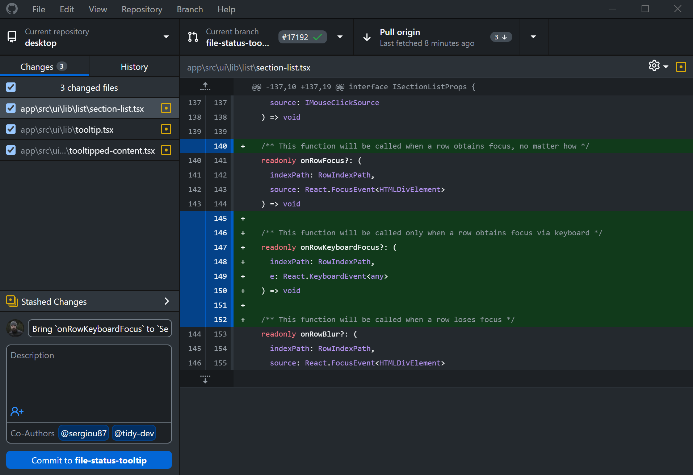
GitHub Desktop
If you use GitHub, there exists a graphical interface to use Git
It can list file that have been changes
The modifications in these files: lines that were removed are in red, those that have been added are in green
The list of modifications works for plain text files (.txt, .r, .md…)
For other (like Word files, you cannot see the changes)

Slide 6
Primers

Slide 7
Some computer science primers
Before we get into it, I would like to explain some basic computer science concepts so that you can understand the rest of the class better:
What is inside a computer?
The difference between sequential and parallel task execution
Local vs cloud computing

Slide 8
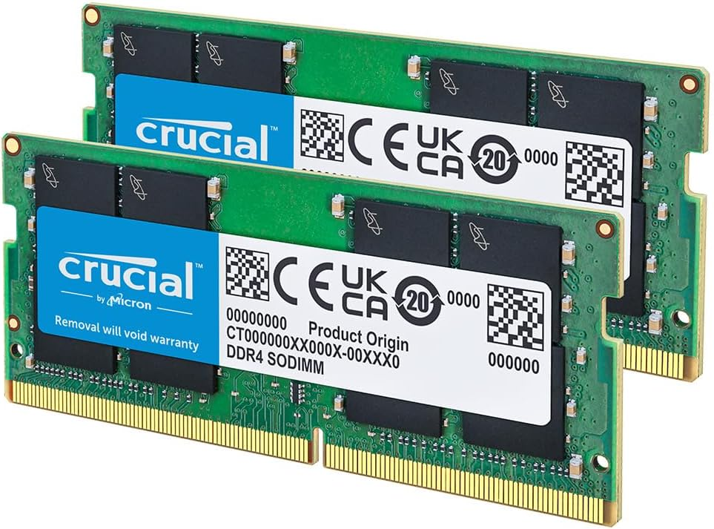
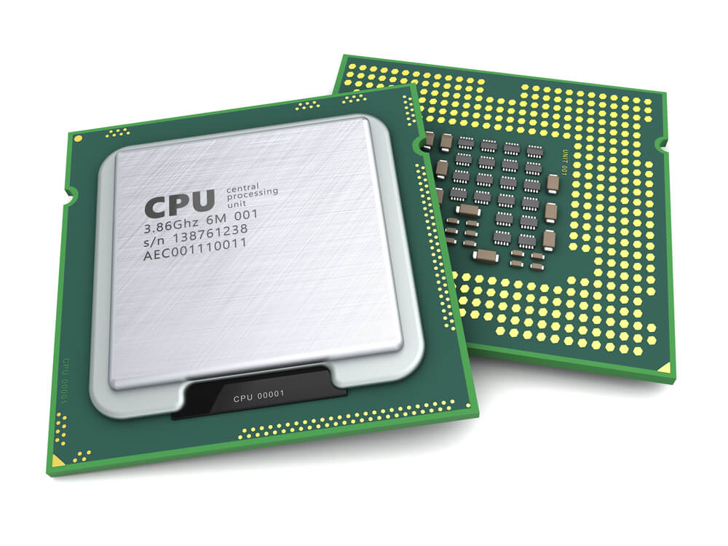
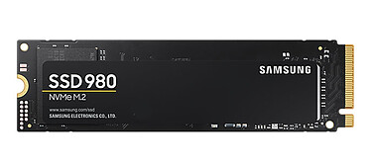
A primer: what’s inside a computer?
Or at least, what should be of concern to you:
RAM
(Random Access Memory)
CPU
(Central Processing Unit)
SSD
(Solid State Drive)

Slide 9
RAM
This acts as very fast, temporary storage
Most common RAM size is 16Gb
This will be fine for most data science tasks
I use 32Gb, that can handle quite sizeable datasets of dozens of millions of rows, and quite a few variables
R loads all your data there, this can be a problem:
If you load a dataset that is too big, R can crash
If you do computations that require heavy data manipulation (e.g. calculating distances between all pairs of data points), the resulting matrices will be too heavy and R can crash
Note: this is a limitation of all languages and packages that do data manipulation in memory (e.g. Pandas on Python)

Slide 10
SSD
This is where your data is stored
Most computers today use SSDs as storage (the slower alternative is hard disk drives)
Except in cheap laptops: they give you one SSD, and a big hard disk drive on which to store your data
This can act as temporary RAM if it is fully used
On Windows, we call that the swap file
However, it is slower than RAM
Useful when you run out of RAM, and this is why you may use datasets that are larger than your RAM size (up to a certain point)

Slide 11
CPU
This is where computations happen
Two big parameters (among a few others):
Clock speed (e.g. 3Ghz, 4Ghz, etc.) is how fast your computer is
Number of cores and threads per core, allows to perform tasks in parallel
Usually, a faster CPU will mean faster data manipulation
Unless you have a bottleneck somewhere else (e.g. not enough RAM)
More cores will matter if you perform tasks in parallel

Slide 12
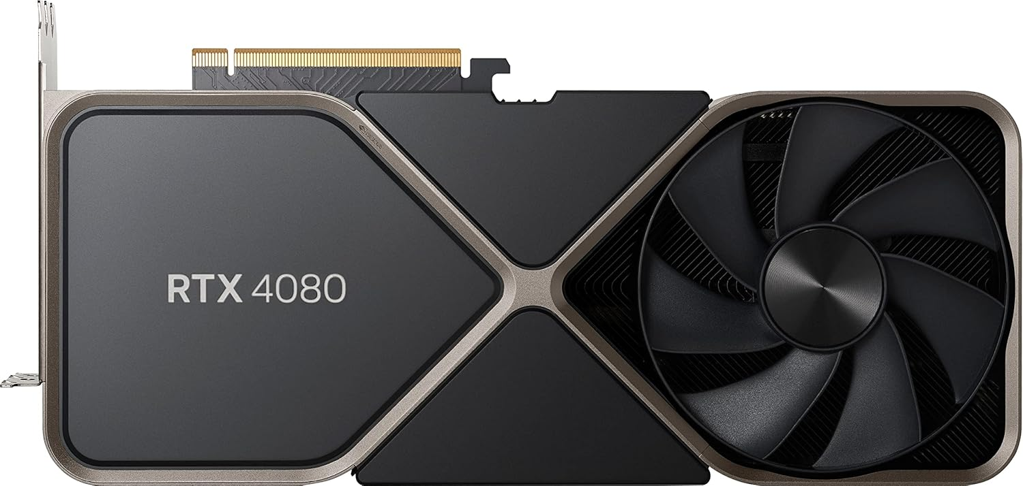
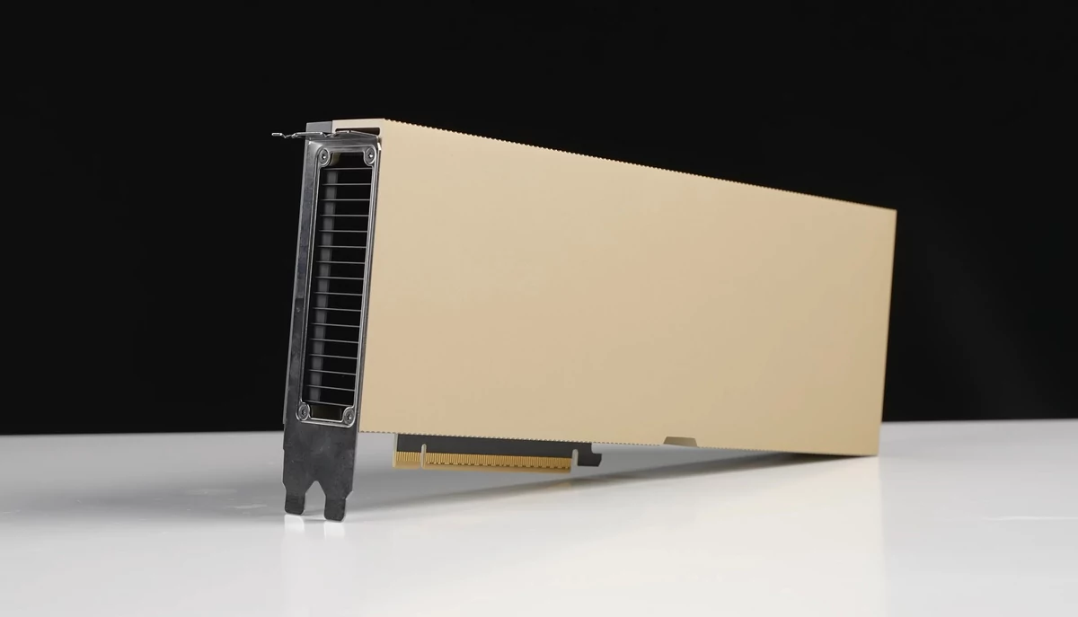
Graphics card, do I need one?
Most of the time, no
A graphics processing unit (GPU) is useful to compute a lot of very simple parallel operations:
Can be used in neural networks, forests, boosting…
There are GPUs made for data science (e.g. Nvidia H100, AMD MI300X)
A single H100 can cost at least $20,000
More typical (and cheaper) consumer GPUs can be used for data science, at the cost of performance

Slide 13

Graphics card, do I need one?
In R, you may have a hard time finding GPU-accelerated packages
Also, to my knowledge, in R you can only use Nvidia graphics cards for this, which are more expensive than their competitor
You might have an easier time with Python
Also, if it’s on your own computer (locally), you might be quickly limited if the data gets too big

Slide 14
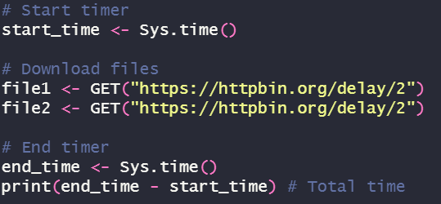
Sequential vs parallel
Imagine you want to download multiple datasets using R (see .qmd)
R downloads the first file, then the second, then we stop the timer
In this programme, R does these step sequentially, one after the other

Slide 15
Sequential vs parallel
Here we need to wait for the first file to be downloaded before downloading the second one
Theoretically, should we wait for the first one before downloading the second?
No, the completion of the second task fundamentally does not depends on the second one
If two or multiple tasks are each independent of one another, we can do them in parallel

Slide 16
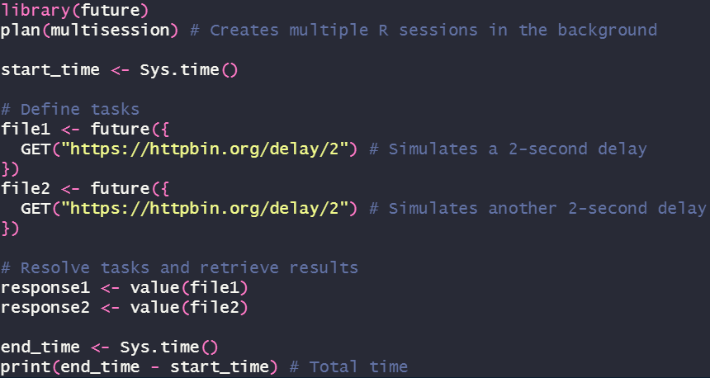
Sequential vs parallel
Notes:
There exists plan(multicore) but it only works on Unix-based systems (so, Linux and possibly Mac)
First you define the tasks; but they are not executed immediately. You resolve them later.

Slide 17
How does it work?
The total time it takes for the code to run is:
Sequential: sum of all the processes
Parallel: time of the longest process
What happens really is this:
CPU
CPU
Core 1
Core 2
Core 1
Core 2
Sequential
Parallel
Core 3
Core 4
Core 3
Core 4
Notes:
I put 4 cores here, but you can have 8, 12… or some servers have 64

Slide 18
How does it work?
CPU
CPU
Core 1
Core 2
Core 1
Core 2
Sequential
Parallel
Core 3
Core 4
Core 3
Core 4
A CPU has multiple cores (~ workers)
Then , cores can have multiple threads, but this is a story for another time
Natively, R uses only a single core to work
You need to explicitly write code for R to use multiple cores (hence the future package)

Slide 19
How does it work?
CPU
CPU
Core 1
Core 2
Core 1
Core 2
Sequential
Parallel
Core 3
Core 4
Core 3
Core 4
What future does: it distributes all the tasks to your available cores
So the maximum number of parallel tasks is limited by the number of cores in your CPU (on Windows; on Unix it can be more)

Slide 20

Local vs cloud
Right, now you are working locally on your computer/laptop
The data you work on is stored on it
Your resources are limited to what is inside your computer
So if you need to do Machine Learning on big datasets with billions of rows, you will quickly realise this is not enough
This is not the only way to work: instead of making your computer do the hard work, you can store your data in servers and instruct other computers to do the dirty job over the internet (cloud)

Slide 21


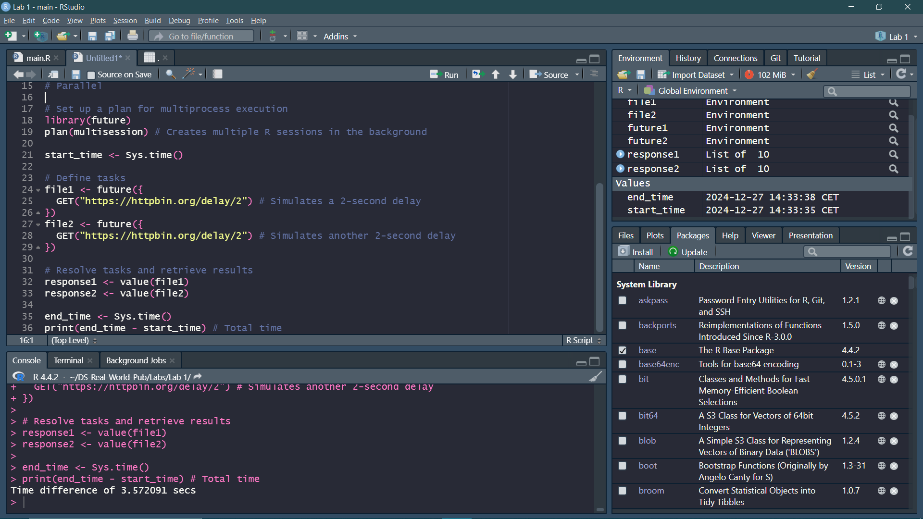
Cloud computing
Some data center somewhere
Send instructions (+ 💸💸💸)
You
Gives back results
(+ pollution 🏭)
Notes:
The servers do the computations

Slide 22

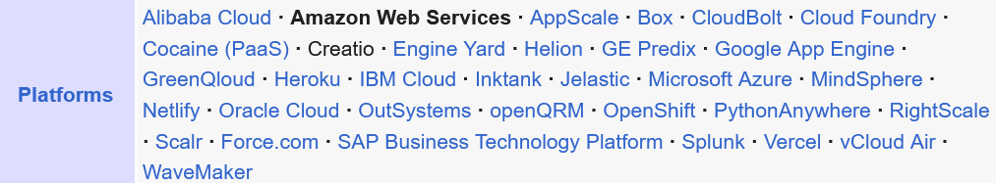
Cloud computing
This is the process behind services like Amazon Web Services, Microsoft Azure, IBM Cloud…
There are a lot
The idea is that you rent resources for you to use: storage, tools, computing power…
You don’t use any of your own computer resources, except connecting to the server(s)

Slide 23
Cloud computing
The offer cloud computing services is quite heterogeneous: some offer platforms capable of handling all aspects of data science projects
Also, you can use multiple servers for parallel computing
Worker 1
2
3
4

Slide 24
Cloud computing
Of course, this costs 💸💸💸
It depends on the resources you want to use: how many servers, how much RAM, what CPUs, GPUs…
The point of cloud computing is that you can employ a lot more resources than what you can fit on a single computer
OpenAI’s GPT-4 training cost over $100 million
One unverified figure states more than 25,000 Nvidia A100 GPUs were used
Fortunately, you shouldn’t have to train models at that scale (but good for you if you do)

Slide 25
Cloud computing
The most used cloud computing service is Amazon’s (Amazon Web Service)
I don’t know how it works, I created an account once but the scope of their service is daunting
There are free tiers if you want to try, and tutorials and books for using AWS if you need to train
I would advise you to work locally as much as you can, however
It might be cheaper long-term to have your own good computer than to rent a server
Plus, it is easier to setup

Slide 26


Cloud infrastructure for sensitive data
Sometimes (like in my case), the data you need to access is on distant, secured servers, because the data is sensitive
In these cases, you are likely to be sharing servers with other users
So expect very stringent limits on the resources you can use
On the Système national des données de santé, I am limited to 20Gb of RAM and 10Gb of storage, though it’s a 64 cores server (that’s great)
On another database (le Programme de médicalisation des systems d’information), I am limited to 16Gb on a crap server that works half of the time
It’s a disaster

Slide 27
Performance | Scalability

Slide 28
Performance, should I care?
Yes: performance is how fast and well your code runs
I have been in situations where I have had to run some complex code on 10+ million datapoints
Initially, it would have taken me weeks to run
By approaching the same problem from a different angle programmatically, I reduced that to just a dozen hours
Performance can depend on your computer (e.g. clock speed) and on the package you use (i.e. how these packages are written)
Notes:
If ity takes just one second to run the code for a single data point, it would take more than 3 months to get results for all data points

Slide 29
Performance: it’s not only your code
How efficient you are at obtaining your results is also to consider
Ultimately, as you get better you will:
Automate the data management and report production parts
Focus more on extracting insights from your analyses, interpretation and communication and/or…
Focus more on managerial roles (supervising other DS, etc.)
Do note: you may spend less time coding and more time doing management/technical leadership tasks over time (some people don’t like that)

Slide 30
Scalability, should I care?
Scalability refers to how well your code works on a larger scale
I.e.: going from a few hundred thousands rows to hundreds of millions
Most of the time: you should not care
Working on big data is rare: if it fits in your memory, this is small data
You may encounter situations where the data does not fit in your memory, but still fits on your hard drive, I call this “medium data”
Big data is the situation where the data does not even fit on your computer, but must be on servers

Slide 31
What if you work on big data?
If you do work on big data, it is likely you will work in an environment that is already set up
You might never need to worry about questions such as “what type of database should I be using to store my huge data?”
This is a data engineer’s work
Be aware of this environment in advance, you will need to plan your programming accordingly:
Knowing the language of the database management system you will be using
How to connecting to it, how to manage multiple threads…
What are the correct packages and tools to use

Slide 32
Writing better code
Before thinking about scalability and performance, you should start following good programming practices
There are general books for this, a well-known one is Clean Code: A Handbook of Agile Software Craftsmanship (there is good advice, just skip all the Java code in it)
I’ll outline here a few main points

Slide 33
Code readability
For the tidyverse, there is a style guide on what your R code should look like: https://style.tidyverse.org/
You should also install what is called a linter
It will show you syntax errors and stylistic issues
On R, it’s lintr (but Rstudio is bad at this. VSCode offers real-time linting)
It does not make your code run any faster
However, it will be easier to read, especially if someone else reuses your code (and this will happen: you will reuse codes from previous colleagues and give codes to new ones, or reuse some code that you did months ago)

Slide 34
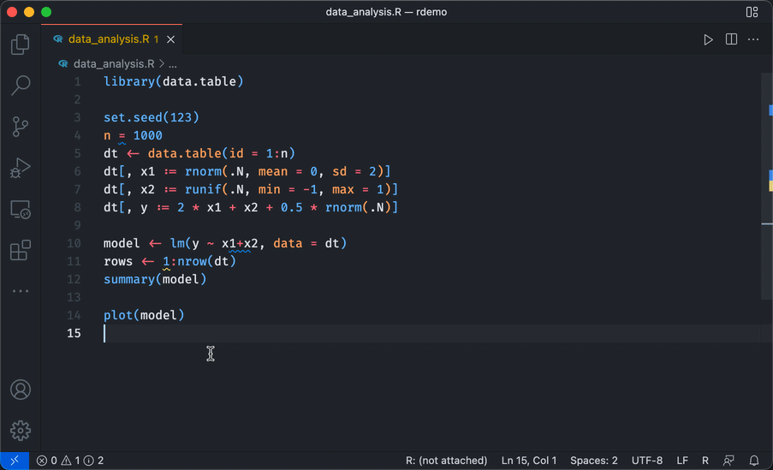
Linting example (on VSCode)
A linter will highlight possible stylistic or syntax issues in your code
It can get annoying after a while
Linter rules are customisable
Keep in mind: it is just a guide

Slide 35
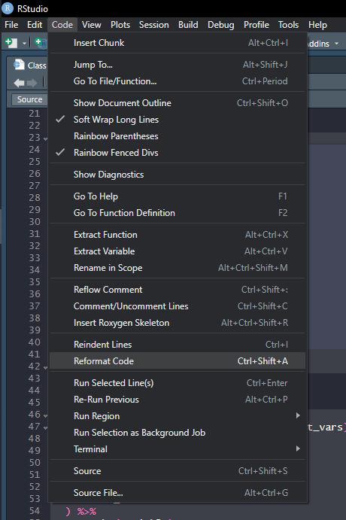









Code readability
If your code looks ugly, click on:
Code > Reformat Code
This will automatically format your code into something more readable

Slide 36

Code reproducibility
Never do anything without keeping a script of what you have done, so no:
Preliminary data management in Excel
You also run the risk of messing up your data
Full analyses only using GUI tools (like R Commander, SAS/Stata/SPSS built-in commands)
Just use these to learn the syntax
Set a seed
Some functions or statistical methods need to set some parameters randomly, or must introduce variation randomly
A computer cannot give random number, they can only simulate randomness using algorithms
A seed makes this random algorithm fixed

Slide 37

AI Programming Tools
Useful if you quickly want to complete your code
Choose your poison:
Integrated AI assistants (Github Copilot, Codium…): these work within your IDE (not R Studio though, try VS Code), they may have context awareness of the project your work on
Not integrated: ask your problem on the LLM of your choice (GPT 4, Claude…)
The quality of the output depends greatly on the LLM you use
Some are better at coding than others
Check benchmarks on the Internet

Slide 38
AI Programming Tools: pitfalls
Non-exhaustive list of garbage that I have had to correct from AI: incorrect syntax, wrong methodology, useless chunks of code…
As a beginner: don’t learn to code from AI, don’t copy-paste code you don’t understand, and be wary of their outputs
LLM don’t understand fundamentally programming and statistics and cannot reason
These are very complex and sophisticated statistical models that can output believable and coherent content given some context
They will fail if you ask them something out of the bound of what they have been trained on: for example, coding on a new, recent package
The problem is that they can fail very confidently (“hallucination”)
Notes:
Had a intern who sometimes copy-pasted code he didn’t understand. It’s a bit worrying, usually…

Slide 39

Are you going to get replaced by AI?
No.
But if you find a way to automate everything I do with AI please tell me

Slide 40
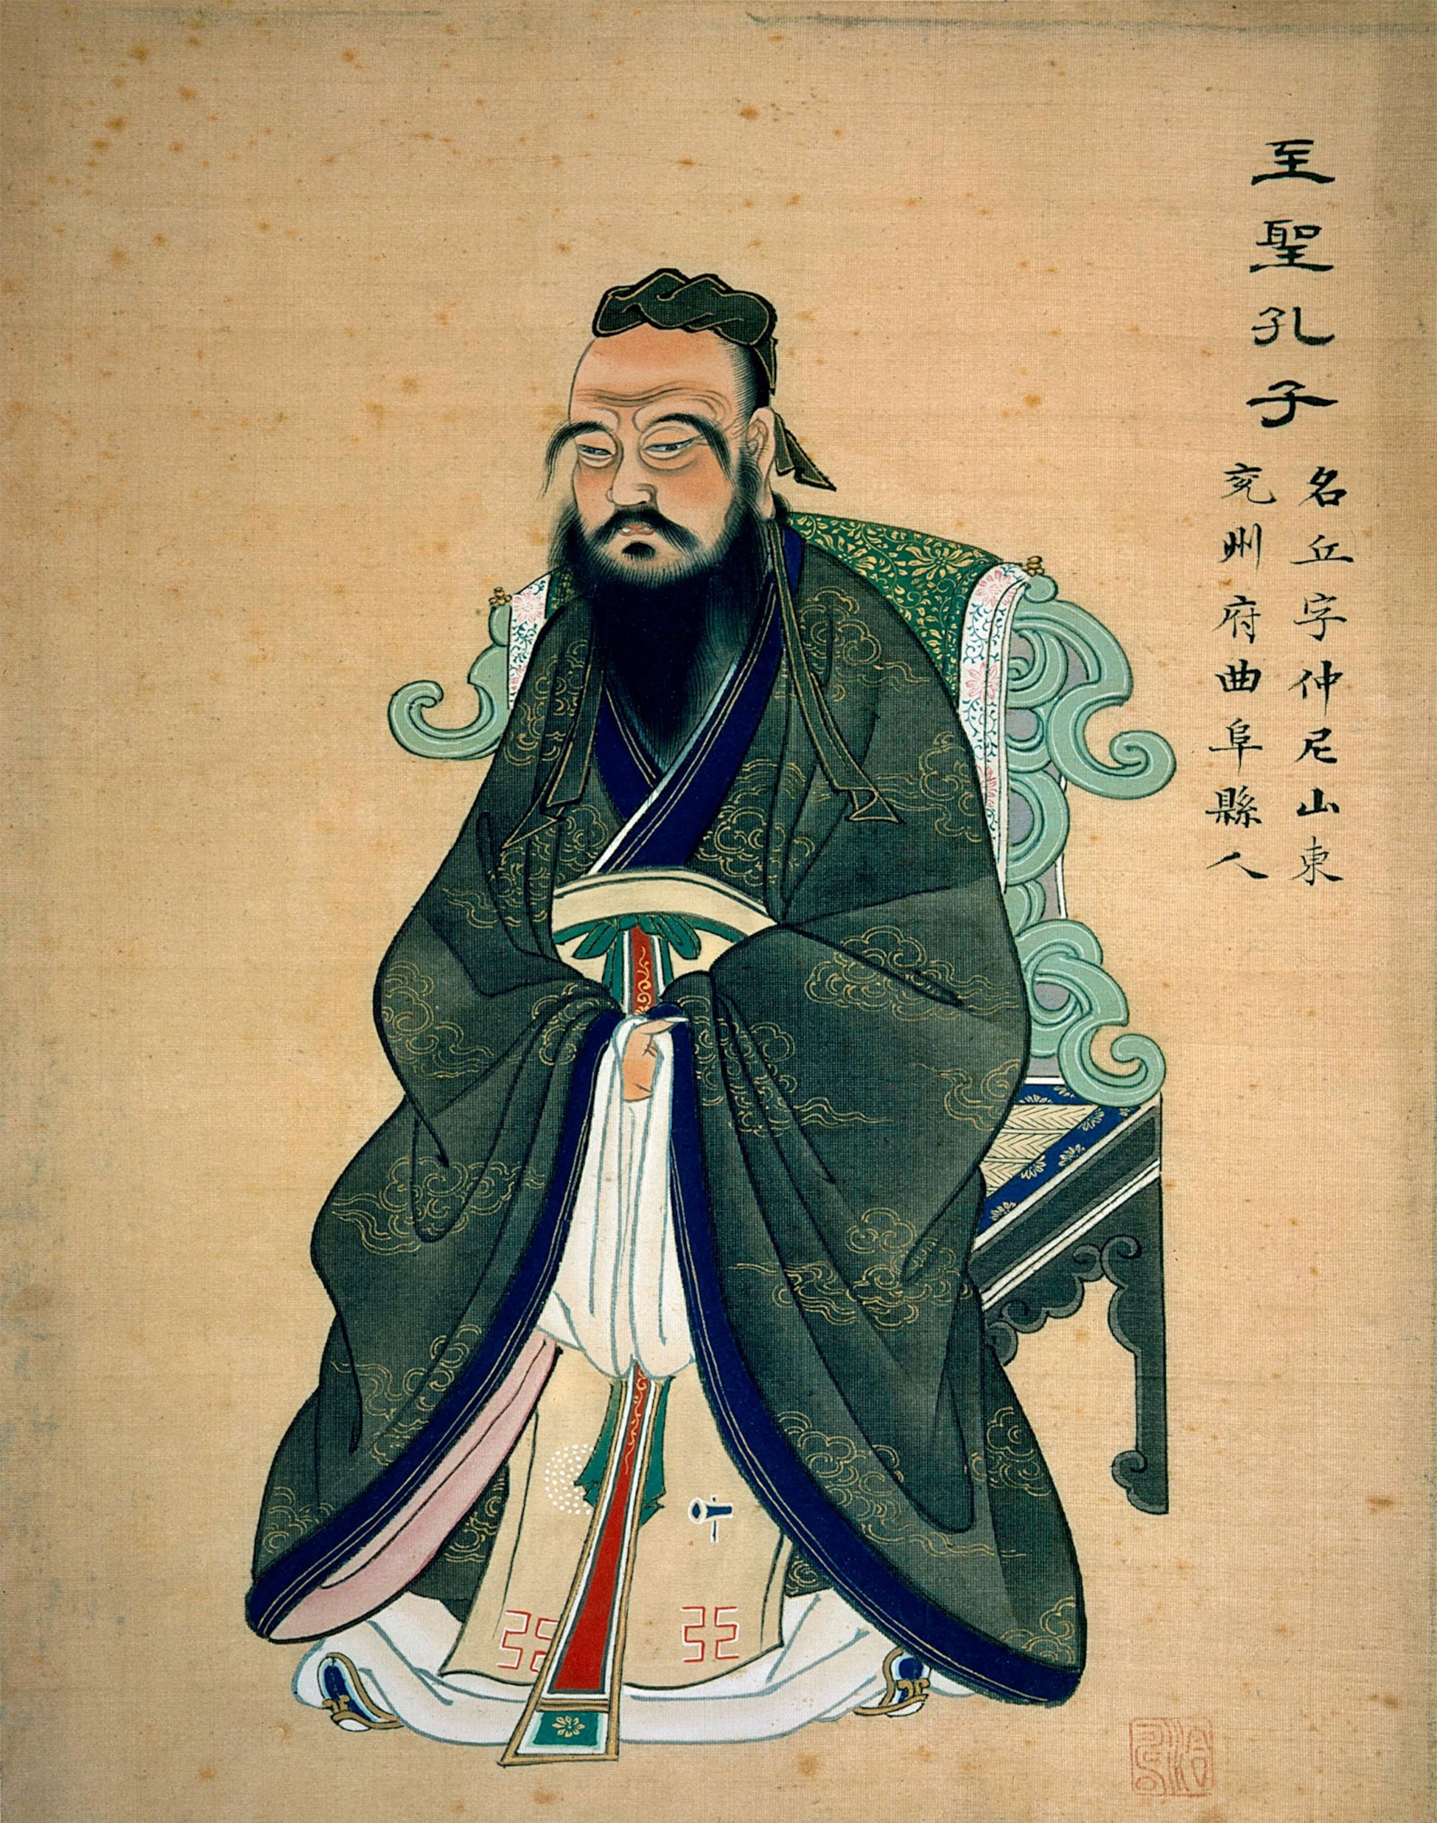
DRY: Don’t Repeat Yourself
Rule of thumb:
If you find yourself copy-pasting your code at least twice, there is a problem
What is the problem with copy-pasting?
This makes your code less flexible
Imagine you have ten variables and you want to create a descriptive table for each one
You could copy-paste the code ten times, and just change the name of the variable
Problem: if you want to make a modification in the table, you will have to modify the same code ten times
Notes:
Problem: this gets progressively more time consuming, and you risk introducing errors in your code

Slide 41
DRY: Don’t Repeat Yourself
If you find yourself copy-pasting your code at least twice, there is a problem
By trying to avoid repetition, you will start learning about a lot of more complex programming tools
So: loops, functions, metaprogramming, functionals, control flow, debugging…
That’s your key from going to a beginner-level programmer to an intermediate-level programmer
Notes:
Problem: this gets progressively more time consuming, and you risk introducing errors in your code

Slide 42
Start writing functions
If you copy-paste too much: think about writing a function
Multiple advantages
This makes your code lighter and clearer
If you want to make a change: modify the function directly
The modification will be effective every time you re-execute this function
At the end of the day, it’s all about tradeoffs. Is it quicker to:
Copy-paste some code X times (and modify it X times if you want to change something)
Write a whole function from scratch

Slide 43
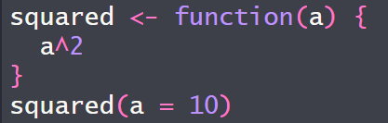
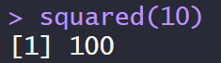
Reminder: R functions
Remember:
A function (usually) needs inputs (here, it is named a)
It does a sequence of steps (here, take the square of a)
It always gives you an output

Slide 44
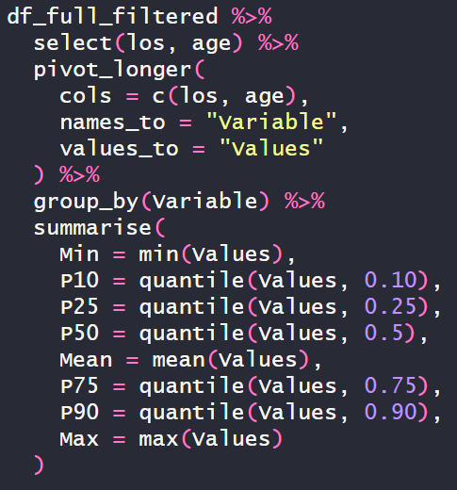
From code to function
This is code to create a descriptive table for continuous variables
It will show one variable per line, and multiple columns with the minimum, quartiles, etc. etc.

Slide 45
From code to function
Questions to ask yourself:
What should my function do?
What are my inputs? I.e. what goes into my function?
Should I add parameters? I.e. are there use-cases, options, that your function should cover?

Slide 46
From code to function
Here:
We want our function to output a distribution table, given continuous and categorical variables
The inputs that we would like to vary are: the data, the continuous variables, the categorical variables
Go to Class 5.qmd

Slide 47
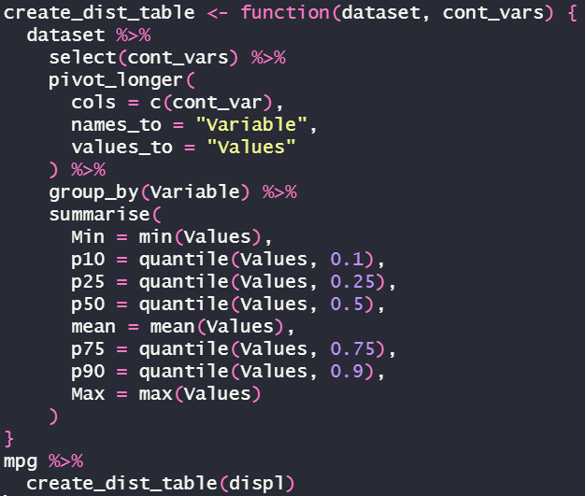







Start slow
First, encapsulate your code in a function
At first, create the simplest case
Here, we will just allow for one variable
However this function won’t work:
displ is a variable in my dataframe, but R expects an object

Slide 48
Injection and the {{ operator
R looks for an object named displ in your environment
It does not understand it is a column in a dataframe
So we need to tell him explicitly
Enter the {{ operator
We are getting into more complicated R programming
It defuses an argument
Defusing means: don’t execute this piece of code immediatly
{{ evaluates the code later (injection), in the context of a dataframe

Slide 49
Data-masking, metaprogramming
These curly brackets are a very powerful tool. There are others.
Read the rlang package documentation for more information and the Advanced R book, especially:
Data masking
Metaprogramming

Slide 50
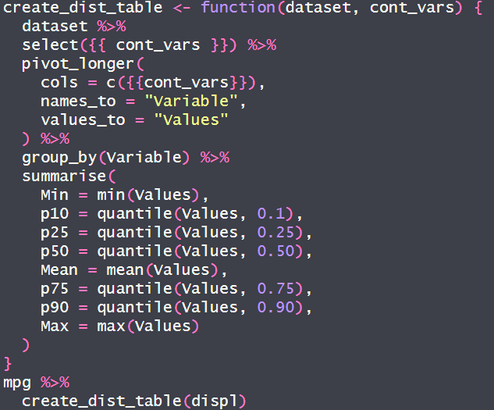
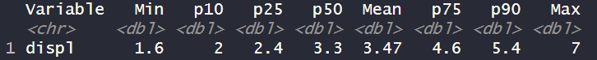


Start slow
Now it works
But only with one variable. What if we want multiple ?

Slide 51
Dynamic dots: …
Dynamic dots (…) are a special type of argument
They allow:
Forwarding: let’s say you have a first function, in which you call a second one, dynamic dots allow you to use argument from the second function inside the first one
Collecting multiple arguments
In our case, using them allow us to input multiple variables

Slide 52
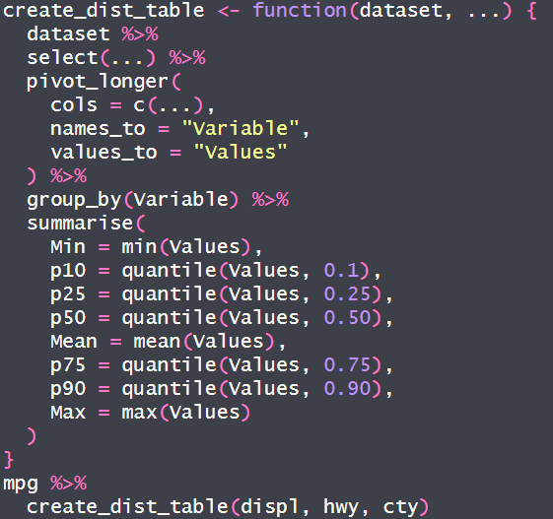
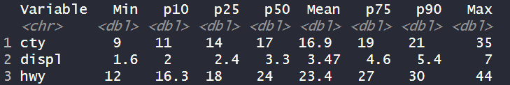



Multiple continuous variables
Now, what if you want you compute the distribution according to categorical variables?

Slide 53
Multiple continuous variables
1
Now, what if you want you compute the distribution according to categorical variables?
We would have to add:
A new argument
Put it in the select
Put it in the group by
2
3

Slide 54
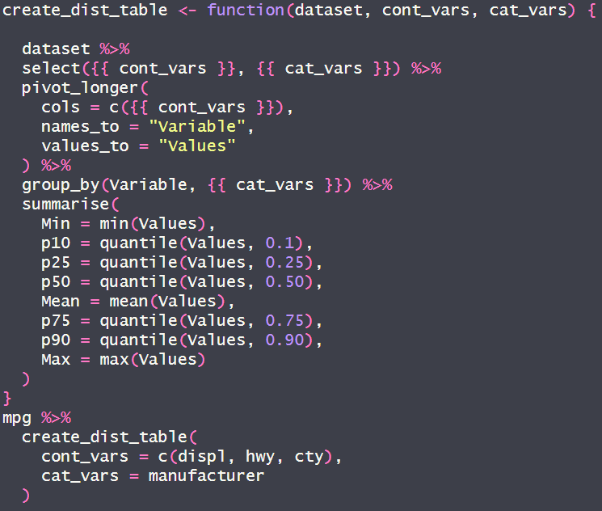
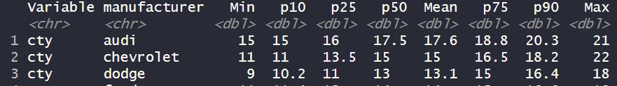



With categorical variables
I voluntarily omitted something earlier:
We could use multiple continuous variables as input
Include a new argument, cat_vars, then place this argument between brackets at the correct locations, and it will work

Slide 55
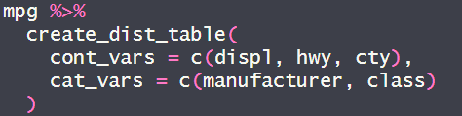
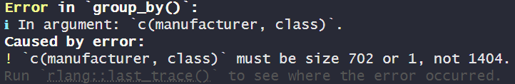
With multiple categorical variables
For multiple categorical variables, let’s try the same technique
And it won’t work. To be frank, I’m not sure why.

Slide 56
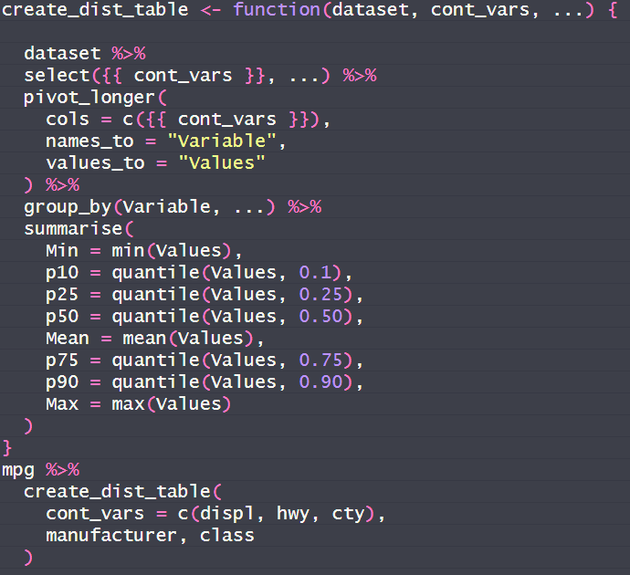
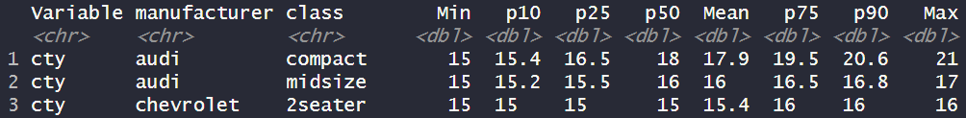
Dirty fixes
Sometimes you won’t manage to find the best solution, what I did:
I used dynamic dots for the categorical variables
The syntax is ugly and it is not clear the dynamic dots what should be
But at the end of the day, it works
Just put a comment to remind yourself that the dots should be used for categorical variables

Slide 57
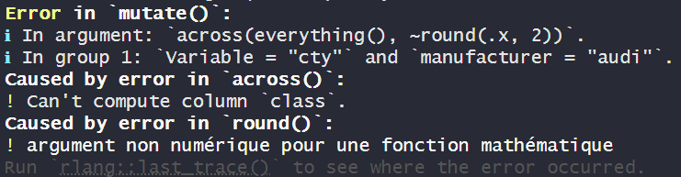
Managing errors
You may have noticed a large chunk of your programming time is spent on solving errors
Good news: the more you code, the less errors you will encounter
Bad news: you will still get stuck, but on more complicated errors
When there is an error, R will show what caused the problem
Most times, you will find the solution there, so read it.

Slide 58
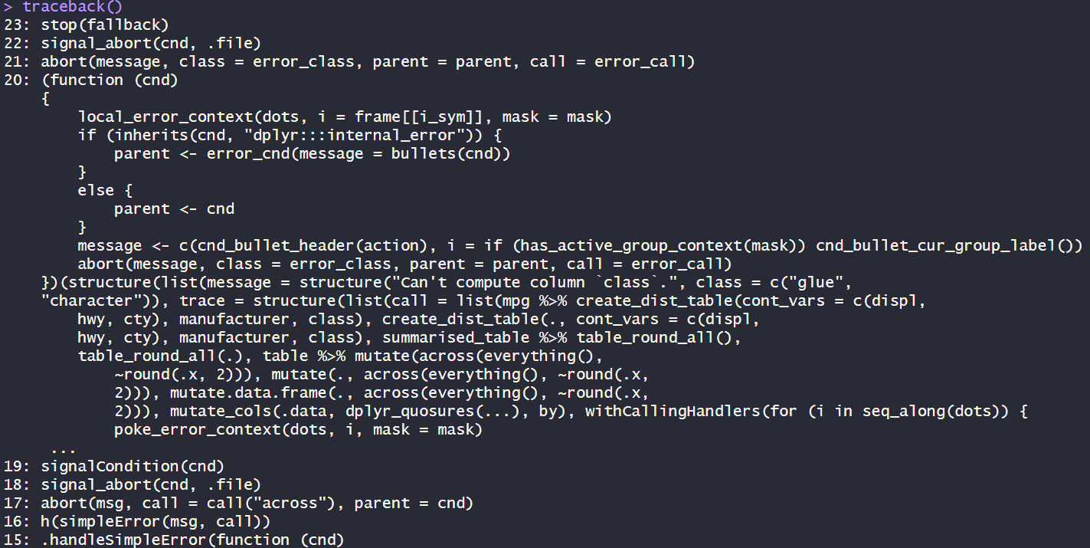
The traceback
If it is not enough, the traceback() function will show each function that has been executed (starting from the last one)
This can be hard to read

Slide 59
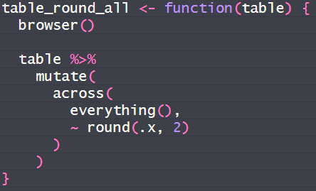

The debugger
The most effective tool for troubleshooting errors in your functions is the interactive debugger
In it, add the browser() function at the beginning, or just before the line that outputs an error
This also works inside for loops

Slide 60
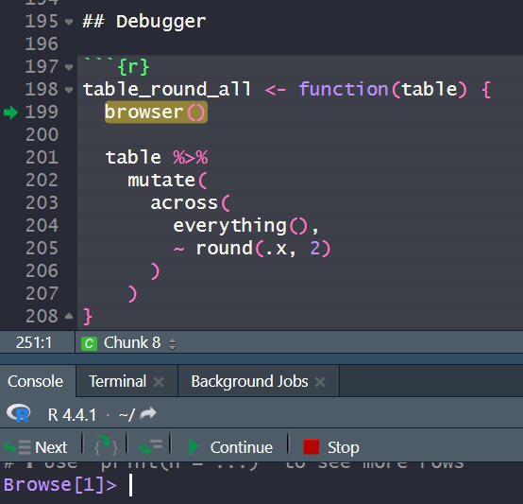
The debugger
R will stop the execution of the code at the line in which you call the browser function
All objects that are created during the execution of the function can be seen in the environment and modified
Notice the buttons above the console have changed, you can:
Execute the next line
Execute the remainder of the loop (or the rest of the function)
Go “inside” another function
Stop the debugger
Notes:
Show browser function in R

Slide 61
Preconditions
The point of preconditions is to catch errors before they happen
For example, in our previous example: we would like to avoid using a character variable as a continuous variable
How to do it:
Verify that your input satisfy a priori conditions (preconditions)
For example, that our continuous variables are not character variables
If the condition is not satisfied, we use the stop() function to stop the code, and provide a message to explain why the function was stopped
You will need to understand control flow to create preconditions

Slide 62


Control flow
This includes: if and switch(), for and while loops
We will focus on if (switch is just a more advanced if-else)
In pseudo-code, the basic idea behind an if statement is this:
if (condition) {
execute this
} else {
execute this
}
So, if the condition is TRUE, you will execute the part of the code in yellow.
If it is not true, you execute the green part of the code

Slide 63
Control flow
So for a precondition, it simply means that if some condition is verified, we stop the function:
if (condition) {
stop
}

Slide 64
Control flow
if statements are good to add modularity to your functions and overall programming
If you have many if statements at once, consider using the switch function, it is more readable
You can use if statements
Inside if statements
Inside if statements
Inside if statements
Inside if statements
Inside if statements
These are called nested if statements, avoid doing this however.

Slide 65
Unit tests
A good practice that I never implement (oops)
When you create a critical function, or a complex piece of code, implement unit tests:
These are small pieces of code made to ensure you get the correct, expected outputs with your main functions
Your unit tests should always output the same result
Useful to check you don’t break anything when you make changes to your functions
In R, there is the testthat package

Slide 66
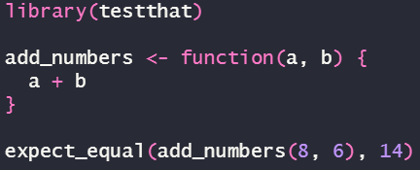
Unit tests – Example
Function to add two numbers
Expect_equal() verifies that the object in the first argument is equal to the value in the second argument
If the condition is verified, your code runs normally
This is an easy situation
For more complex functions you may have to create multiple unit tests
Usually, these are put in separate files

Slide 67
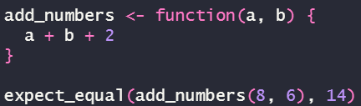
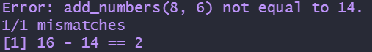
Unit tests – Example
Now, let’s modify the previous function
The unit test will output an error and your programme will stop
There are other kinds of unit tests, you can check everything here one day: https://testthat.r-lib.org/reference/index.html

Slide 68
Functionals
So far, in our functions, our inputs are usually datasets, columns, strings…
Some functions can use other functions as inputs, we call these functionals
In base R, the apply functions are functionals
With these, you can apply a function to every element of some list/vector/dataframe…
But like most base R functions, we will instead see its (better) equivalent from the Tidyverse: map

Slide 69

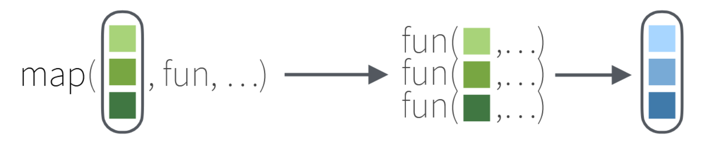

The purrr package
There are many functions in purrr, I will show you two great ones: map and map2
New list
Some list (e.g. a dataset) with multiple elements (e.g. variables)
Apply function to each element of the list (e.g. each variable)
Any function

Slide 70
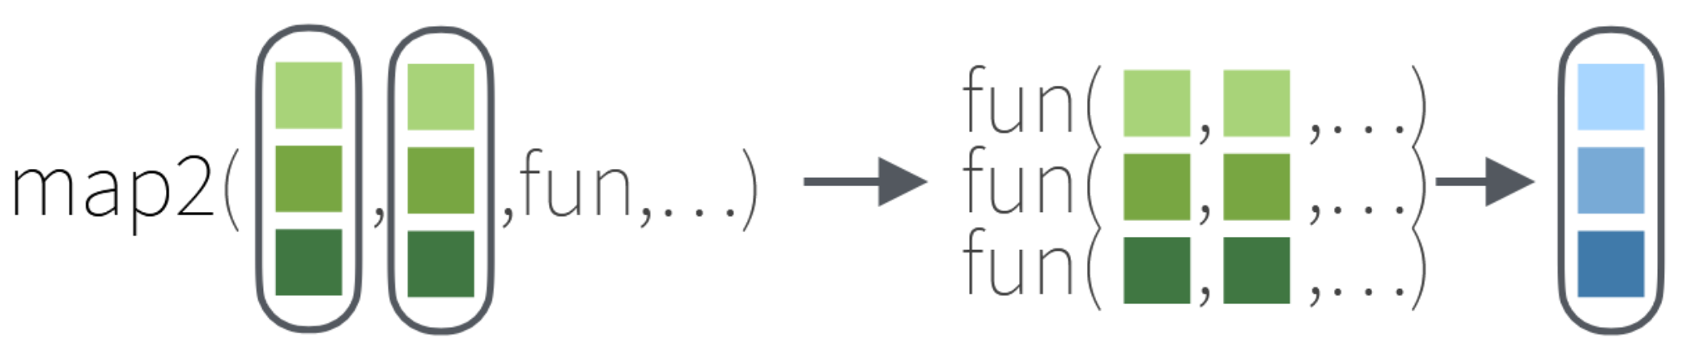

The purrr package
Many functions in purrr, I will show two very powerful ones: map and map2
New list
List 1
Apply function to:
- element 1 of lists 1 and 2
- element 2 of lists 1 and 2
- element 3 of lists 1 and 2
…
List 2
Check Class 5.qmd

Slide 71

Parallelisation
Earlier in the class, I showed you how parallelisation works
In R, the big package to do this future
I never use parallelisation: I didn’t feel the need to, and I fear it may introduce more problems than it solves
Nevertheless, feel free to take a look at the futureverse: https://www.futureverse.org/
There is a package that allows you to directly implement parallelisation for the map functions: furrr

Slide 72

The furrr package
Very easy to implement:
Just create multiple R session with plan(multisession, workers = x), with x being the number of cores that you want to use (must be between 1 and the number of cores in your CPU)
Then, replace your map with future_map
That’s it.
See Class 5.qmd
Does it make your code go faster though?

Slide 73
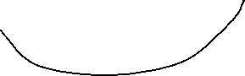

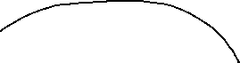
It’s not always worth it!
In theory, parallelisation should make your programme go faster… in practice, it’s hard to tell. It depends on the functions that you use and the size of your data.
Chunk
Output
DATA
Chunk
CPU
Sorted output
Output
Output
Cut
Chunk
Chunk
Output
Shuffled!

Slide 74
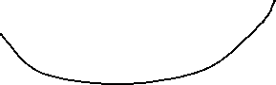

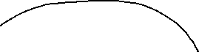
It’s not always worth it!
Chunk
Output
DATA
Chunk
CPU
Sorted output
Output
Output
Cut
Chunk
Chunk
Output
Shuffled!
If you mess up in your code, you might feed the whole dataset to each worker (R may crash if it’s too big)
Also, cutting into chunks, sending these to the workers, and sorting/aggregating the outputs can take more time than a sequential programme if the data is very large

Slide 75
Packages with built-in parallelism
Be aware that some packages have built-in parallelism, and can automatically take advantage of your multi-core processor
For example, for Random Forest, the package ranger
On the high performance computing page on CRAN, they list good, well-maintained R packages that allow for parallel computing

Slide 76

Growing out of the tidyverse
👋👋👋
One day, the Tidyverse won’t be enough for your data manipulation
Two reasons:
It can get rather slow. Especially when you work with many groups in your data (> 100,000)
It is not the most memory efficient package
In this case, you use data.table
There is also collapse now, which could apparently be faster than data.table (it depends on the benchmarks…)

Slide 77
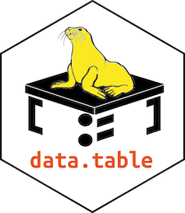
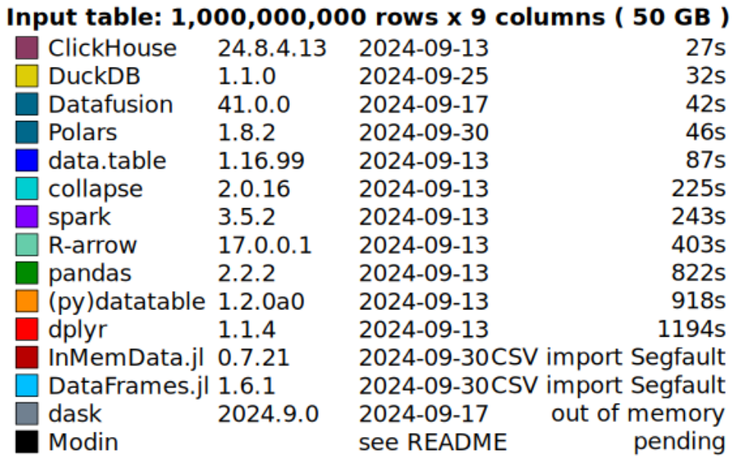


data.table
This package is made for working with large datasets that still fit in the memory of your computer
It is a lot faster and more memory efficient than dplyr
Another package, dtplyr, allows use dplyr syntax while using data.table under the hood, but I advise you not to use it at first
This is just importing the data
Benchmark from 09/2024 here

Slide 78
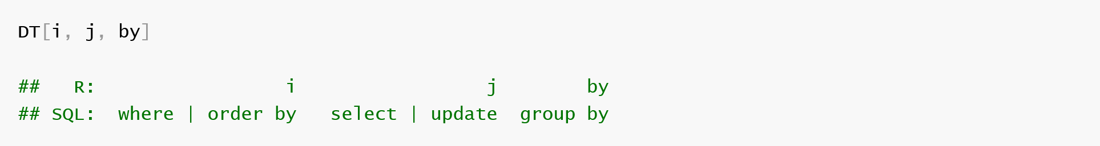


data.table
Syntax is quite different from dplyr (and a bit more complex)
Note: DT here is the name dataframe, it’s not a function
Instead of multiple functions like select, mutate, group_by, everything is done in these square brackets.
In i: you filter observations
In j: you select or modify columns
In by: computations by group
DT <-

Slide 79
data.table
Presenting all the functions would take too long, you can learn that by yourself one day here (check the vignettes section for tutorials)
However, there is one particularity of data.table that makes it very memory efficient compared to dplyr: reference semantics
This has saved me multiple times; it can be the difference between R crashing and giving you results

Slide 80
Reference/in-place modification
When you modify a data.frame using dplyr’s mutate, it does not modify the original dataset
It copies the dataset, modifies it, and then replaces the old one
Essentially, you must have enough memory to hold the dataframe twice temporarily
When the operation is finished, R does garbage collection (it erases the previous dataset from memory)
This can get more problematic with long pipelines if garbage collection occurs at the end
Data.table can avoid this by directly adding column inside the original dataset
We call this by reference, or in place

Slide 81



Reference/in-place modification
`:=`
Copy
mutate
Original
Garbage collection

Slide 82
Reference/in-place modification
`:=`
Very easy to do, just use the := operator (no need to use the <- operator to assign to an object)
df[, c := a + c]
For multiple columns, use `:=`() :
df[,`:=`(c = a + b, d = a * b)]

Slide 83
I’m out of memory, what do I do?
Data.table is good, but at some point if you need to wrangle a 60Gb dataset on a tiny machine, there is not much you can do.
In this case, you need to use packages that allow for out-of-memory processing
Again, check this list

Slide 84

Arrow
Apache arrow is a whole framework for data analytics that has its own format (parquet)
Link here
In a nutshell, it allows you to use dplyr verbs on data that is too big for your memory to handle
It does not load everything into your RAM at once, you can split your datasets into smaller chunks that arrow processes independently
Arrow also works with other programming languages (e.g. Python)
There is also a tutorial for this package in R for Data Science
I never had to use it, so no example (sorry!)

Slide 85
biglm
Generalised linear models in R can be very memory inefficient
In this case, use biglm
The example for the biglm function gives a quick overview of the intuition behind how to use a big dataset with it
Basically:
Split your huge dataset into multiple chunks
You fit the first chunk with the biglm() function
Then you successively update the model using the update() function on the other chunks

Slide 86
And for fancy models?
You will face situations where you need to use some type of regression (e.g. multinomial logistic) but the way it is coded does not scale well with big data, and you do not know any package that can handle this issue
Pray that someone on the Internet has had the same problem and has found the solution
Because if not, you will have create that yourself
It’s your problem now and I cannot help you. Have fun ☺
Seriously, in this case, try an alternative estimation method, coding from scratch is a pain.

Slide 87

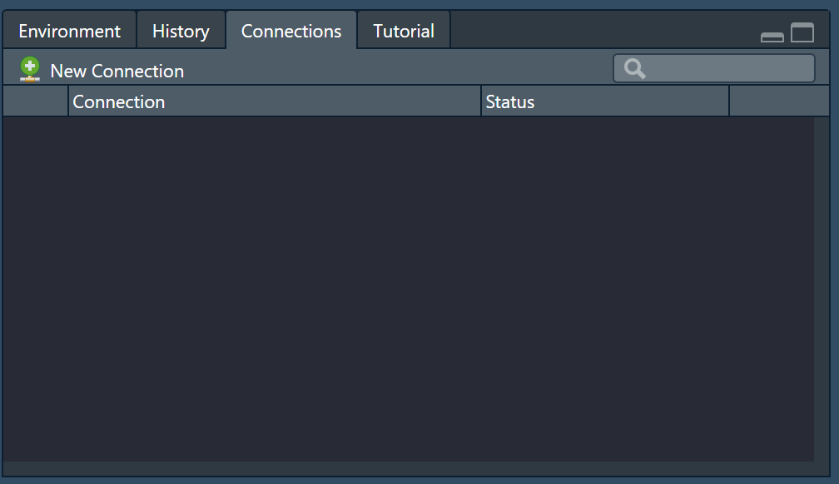
Using servers
When the data is too big for even your hard drive, you will probably work on servers.
Luckily, you can query servers directly from R
You may have never noticed this tab, but this is where you connect to external databases (e.g. a SQL server)
Connections are done using the DBI package

Slide 88
Using servers
Your best tool here will be dbplyr
Its role is to translate your code for the server to understand
I use it to access huge Oracle servers with all national healthcare reimbursement data since the last 10 years
Queries are made using SQL (this will depend on your server)
Dbplyr allows you to write SQL queries directly
It also allows you to use most dplyr functions, they are automatically translated in SQL by the package

Slide 89
Using servers
Working on servers needs more finesse that working locally, you need to think on two levels:
Operations on the SQL server
Operation in R memory
The way we usually work:
Big data wrangling operations are made on the SQL server using dbplyr
When everything is done, we use a dbplyr function called collect() to retrieve the outputs from the server
Note: an SQL server can do data wrangling very well, but you will not be able to do complicated stats on it
This is why we retrieve the data in R

Slide 90
How it works
SQL server
Sends data management code (in SQL)
You (R)
Sends you (smaller) data
Notes:
Be aware that R and the server don’t speak the same language, and don’t have the same capabilities. Dbplyr is an interface to communicate with the server, it translates.

Slide 91
Bonus

